Slide 1


UNIT 2: Home is where heart is
My life on a farm

Slide 2
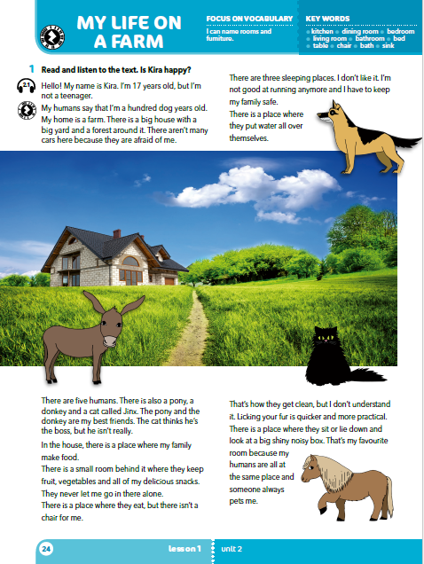
Which animals can you see?
What are they like?
Where is the house?

Slide 3
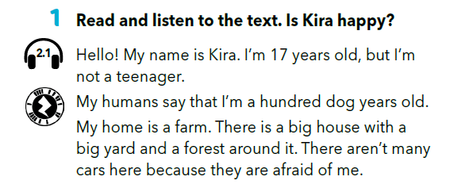
Who is speaking?
What’s her name?
How old is she?
Which animal is she?
Is she a dog, a cat, a donkey or a horse?

Slide 4
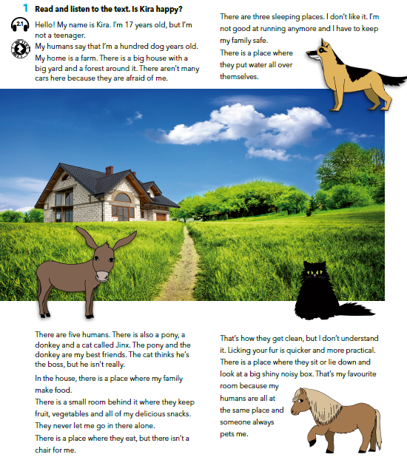

Read and listen to the text.
What’s the cat’s name?
How many people live in the house?
How many rooms are there?
https://www.e-sfera.hr/dodatni-digitalni-sadrzaji/875538be-b0f0-49ab-8f00-352158e06566/

Slide 5
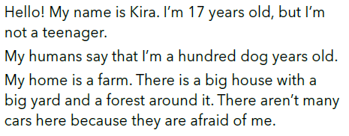
After reading each part answer the questions:
What kind of house is Kira’s house?
Are there many cars around?
https://www.e-sfera.hr/dodatni-digitalni-sadrzaji/875538be-b0f0-49ab-8f00-352158e06566/

Slide 6
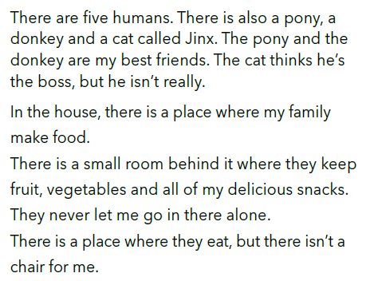
Who are Kira’s friends?
What is the cat like?
Is there a special chair for Kira?
https://www.e-sfera.hr/dodatni-digitalni-sadrzaji/875538be-b0f0-49ab-8f00-352158e06566/

Slide 7
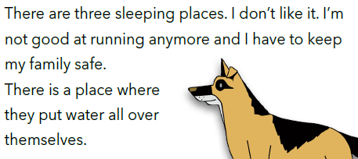
https://www.e-sfera.hr/dodatni-digitalni-sadrzaji/875538be-b0f0-49ab-8f00-352158e06566/
How many „sleeping places” are there?
What’s the word for the „sleeping place”?
Does Kira like the fact the humans don’t all sleep together?

Slide 8
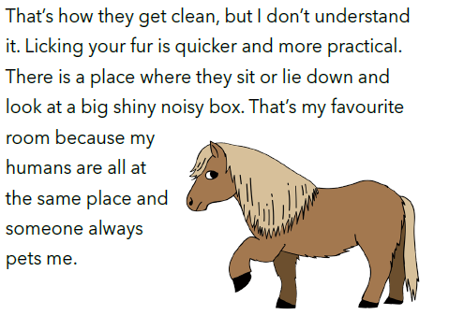
https://www.e-sfera.hr/dodatni-digitalni-sadrzaji/875538be-b0f0-49ab-8f00-352158e06566/
How do humans clean themselves?
How does Kira clean herself?
What’s Kira’s favourite room?

Slide 9
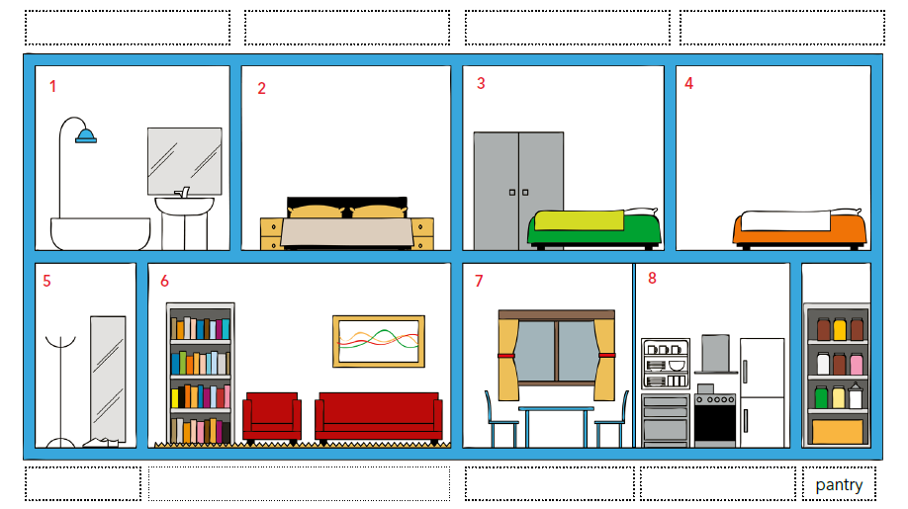
How many things can you name?

Slide 10
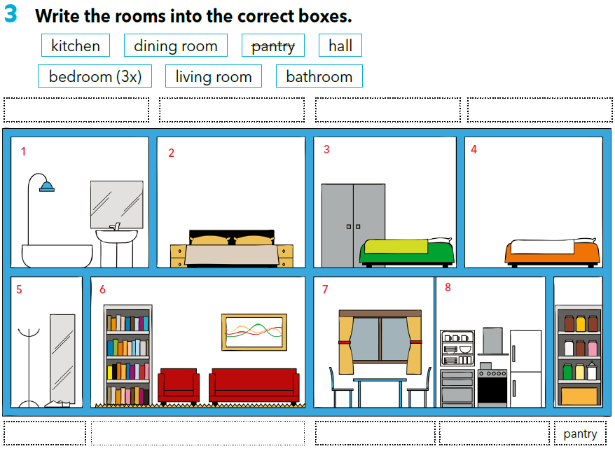
bathroom
bedroom
bedroom
bedroom
hall
living room
dining room
kitchen

Slide 11
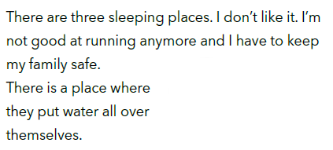
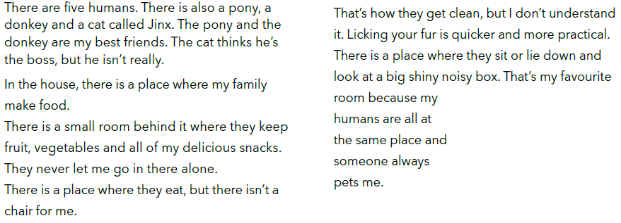
bedroom
Match the rooms with Kira’s
descriptions.
Write the words.
bathroom
kitchen
living room
pantry
dining room

Slide 12
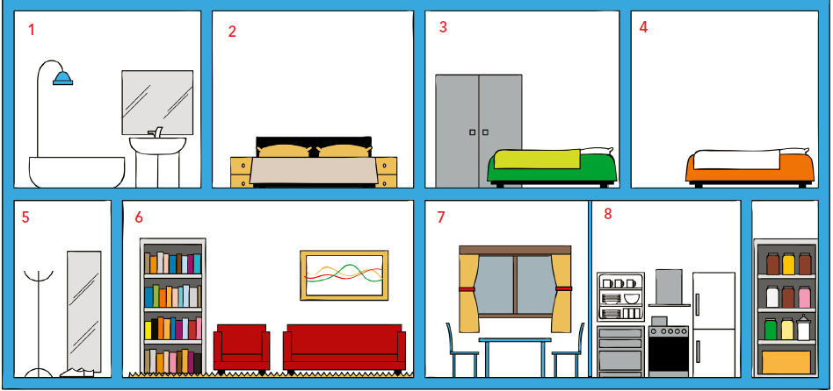
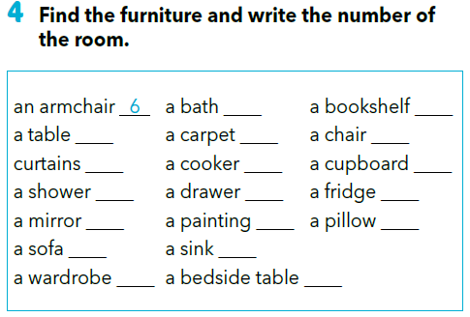
1
6
7
6
7
7
8
8
1
2
8
1, 5
6
2, 3, 4
6
8
3
2

Slide 13
Translate:
an armchair - a painting -
curtains - a sink -
a shower - a bedside table -
a mirror - a bookshelf -
a wardrobe - a chair -
a bath - a cupboard -
a carpet - a pillow -
a cooker - a sofa -
a drawer - a table -
naslonjač
slika
zavjese
sudoper
tuš, tuš kabina
noćni ormarić
ogledalo
polica za knjige
ormar
stolica
kada
ormarić
tepih
jastuk
štednjak
kauč, sofa
ladica
stol

Slide 14
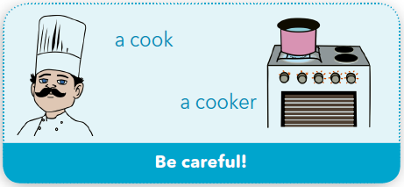
Pazi!
cook = kuhar
cooker = štednjak

Slide 15
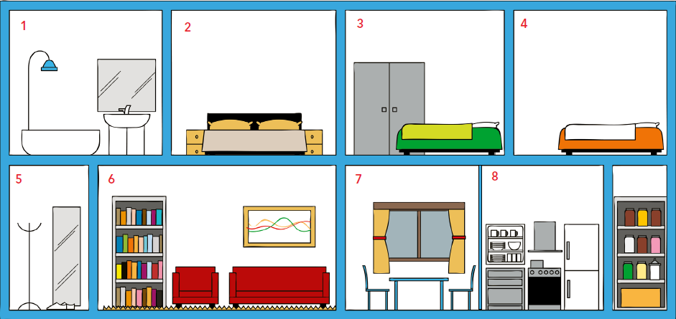
Use the expressions „There is” and „There are” and describe the rooms.
e.g. There is a cooker in the kitchen.
There are two chairs in the dining room.

Slide 16
Play the guessing game.
Look at the picture and try to memorize as much details as possible in 30 seconds.
After that close your book and answer the questions.
Where is the wardrobe?
How many chairs are in the dining room?
Where is a painting?
In which two rooms can you find mirrors?

Slide 17
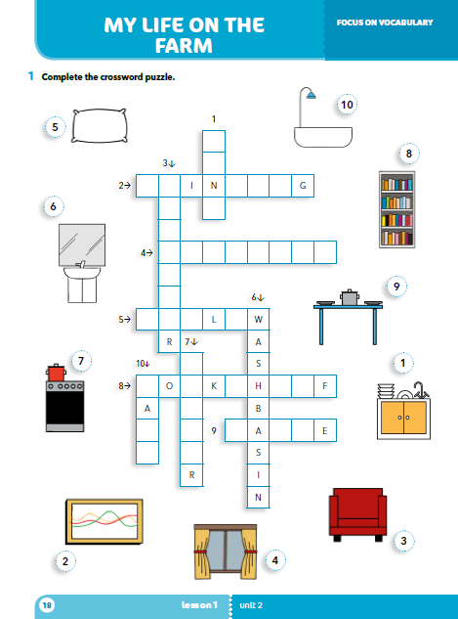
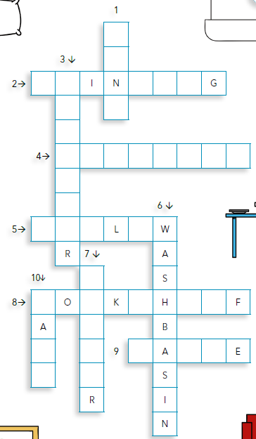
S
I
K
workbook p 18.
P A T I N
R
C
H
I
M
U R T A I N S
A
P L O
C
O
K
E
B S E L
O
T
H
T B L

Slide 18

LEARN MORE.
https://www.e-sfera.hr/dodatni-digitalni-sadrzaji/875538be-b0f0-49ab-8f00-352158e06566/
Where we live
Read the texts and then describe the place you live in by answering the question below the texts.

Slide 19
Self check
SELF CHECK.
https://www.e-sfera.hr/dodatni-digitalni-sadrzaji/875538be-b0f0-49ab-8f00-352158e06566/

